Slide 1
Punctuations,
THE WORDS ACADEMY
www.thewordsacademy.com
And other stuff that are kind of related.

Slide 2
Why exactly are teachers so worked up about punctuations?
www.thewordsacademy.com

Slide 3
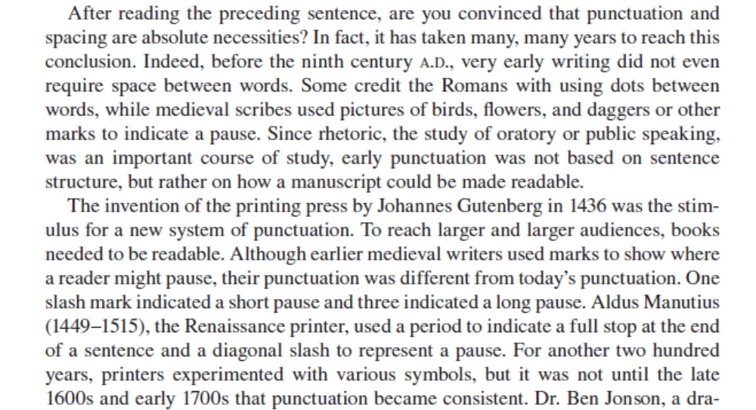
www.thewordsacademy.com

Slide 4
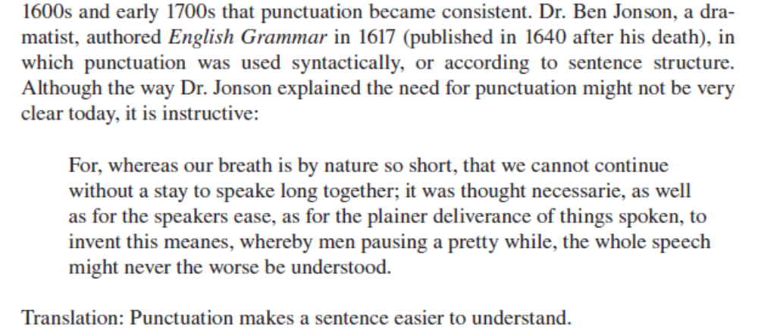
www.thewordsacademy.com

Slide 5
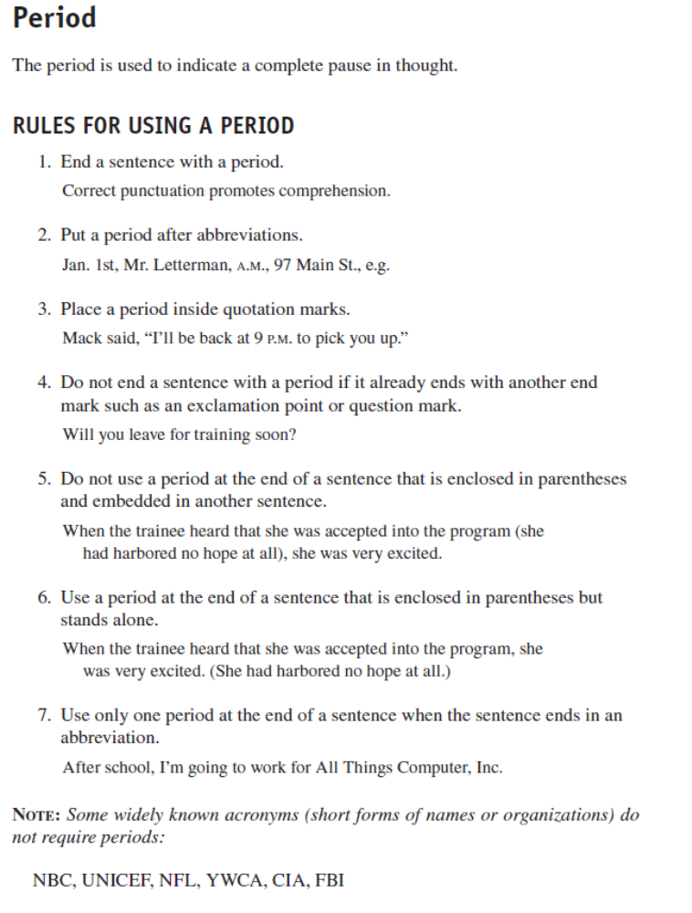
www.thewordsacademy.com

Slide 6
www.thewordsacademy.com

Slide 7
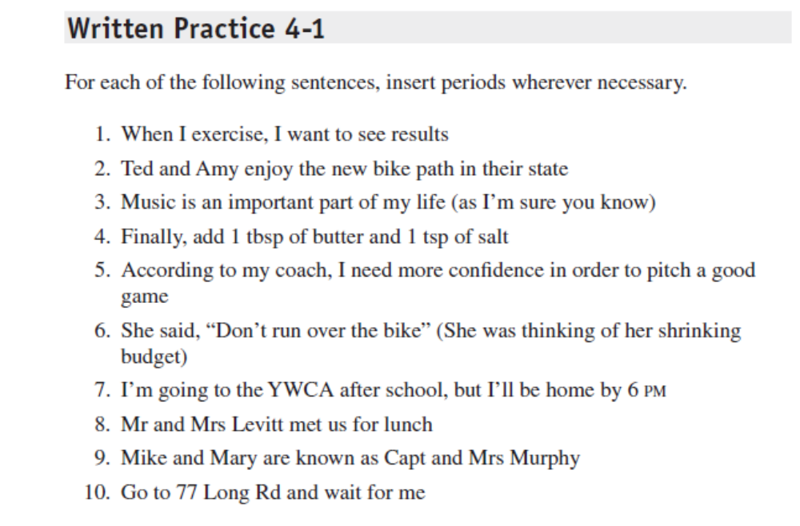
www.thewordsacademy.com

Slide 8
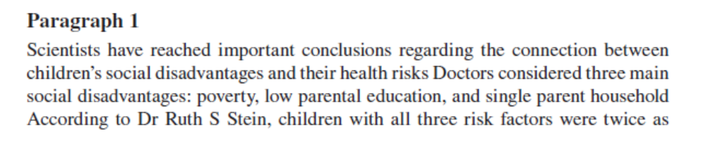
www.thewordsacademy.com

Slide 9
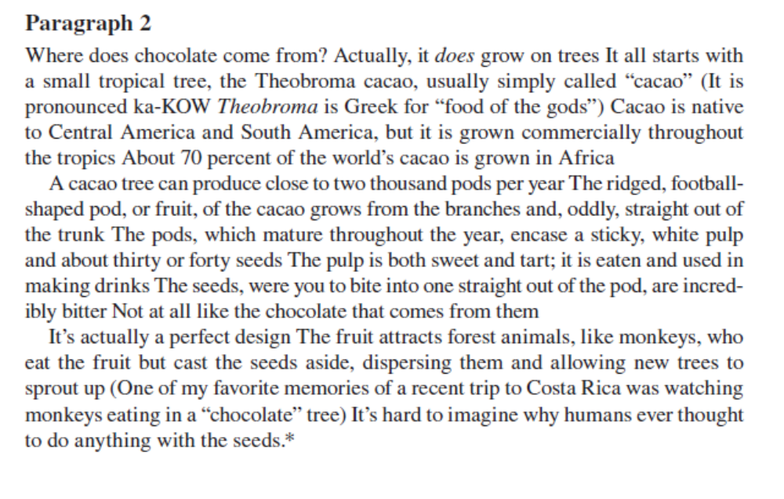
www.thewordsacademy.com

Slide 10
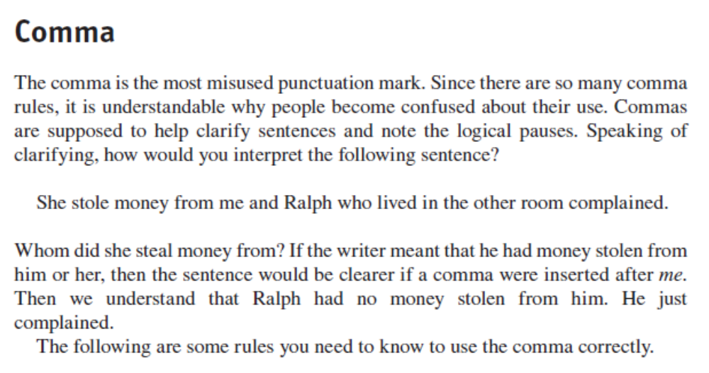
www.thewordsacademy.com

Slide 11
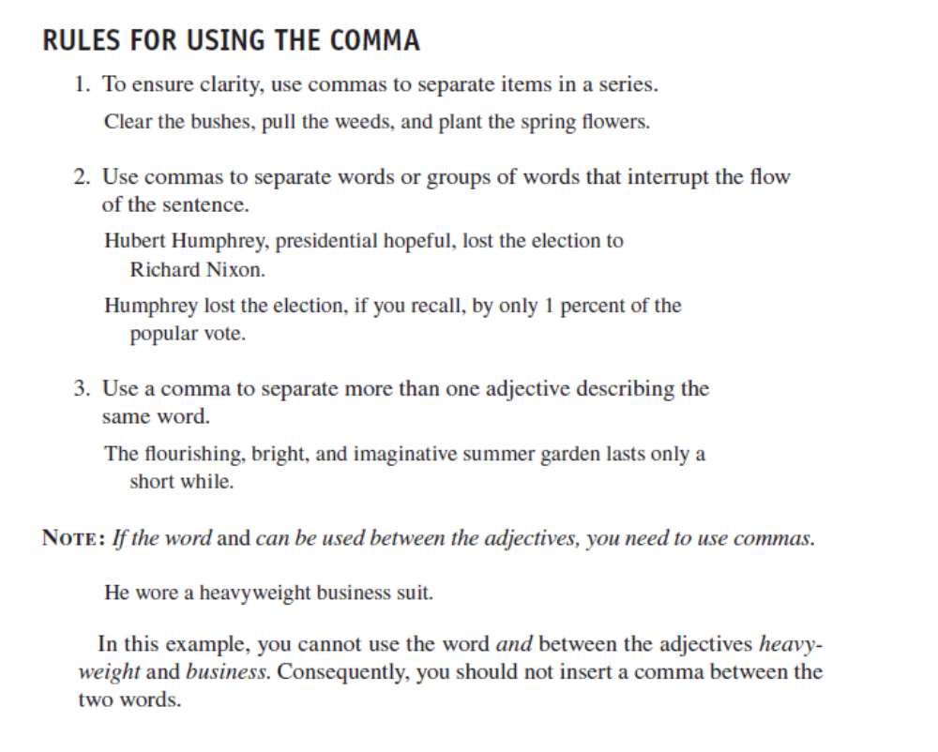
www.thewordsacademy.com

Slide 12
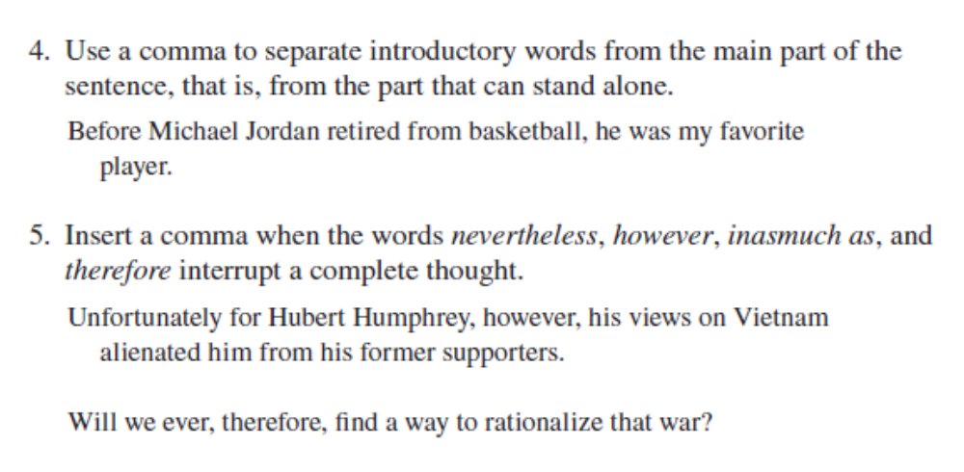
www.thewordsacademy.com

Slide 13
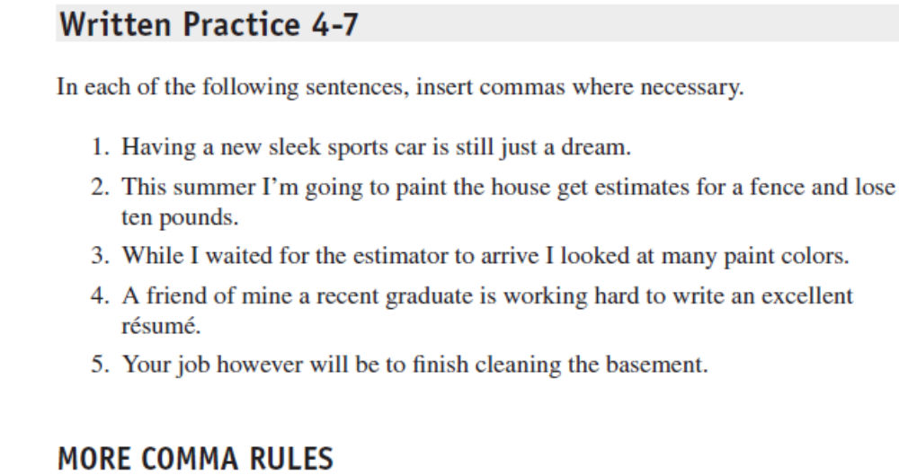
www.thewordsacademy.com

Slide 14
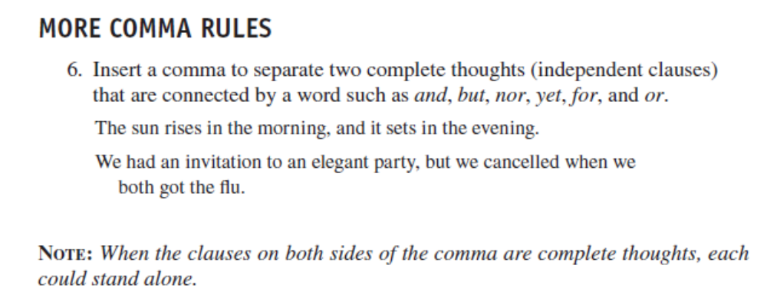
www.thewordsacademy.com

Slide 15
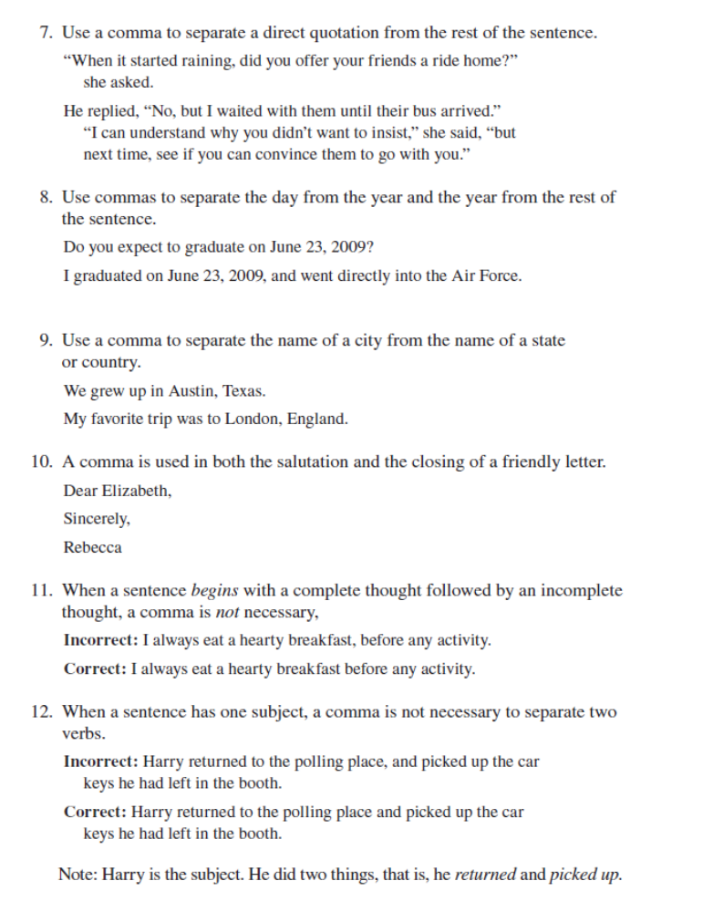
www.thewordsacademy.com

Slide 16
www.thewordsacademy.com

Slide 17
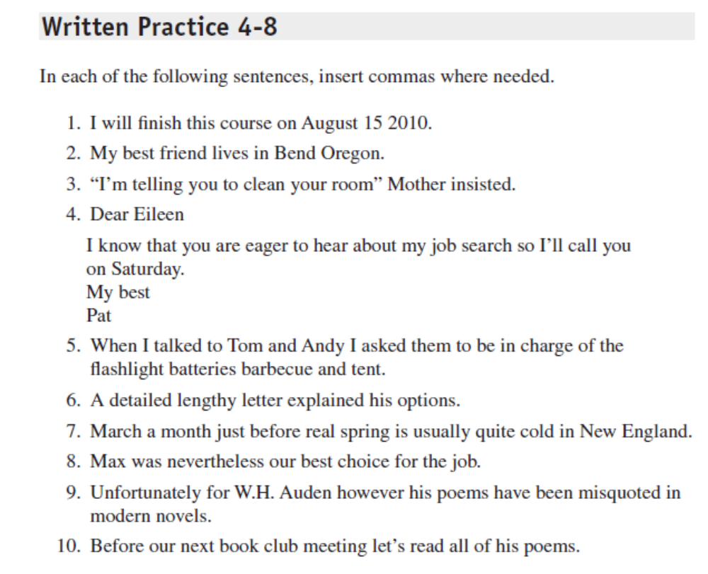
www.thewordsacademy.com

Slide 18
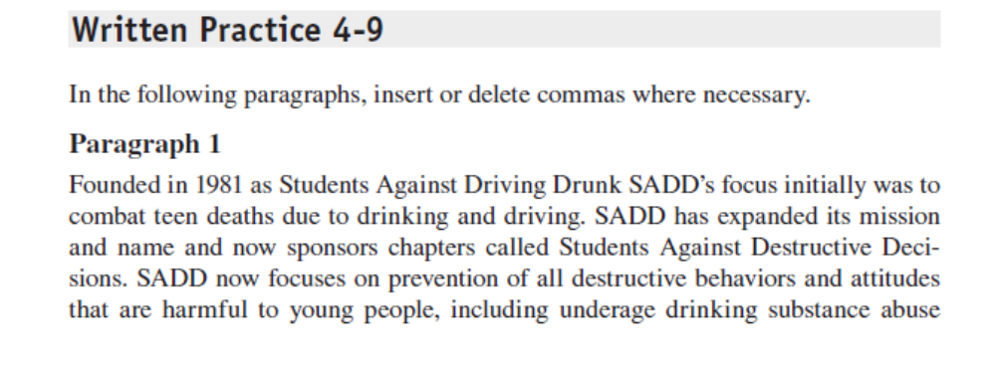
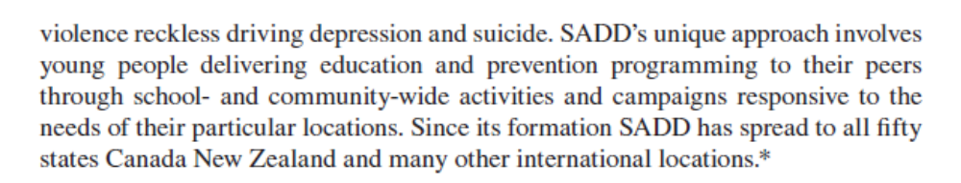
www.thewordsacademy.com

Slide 19
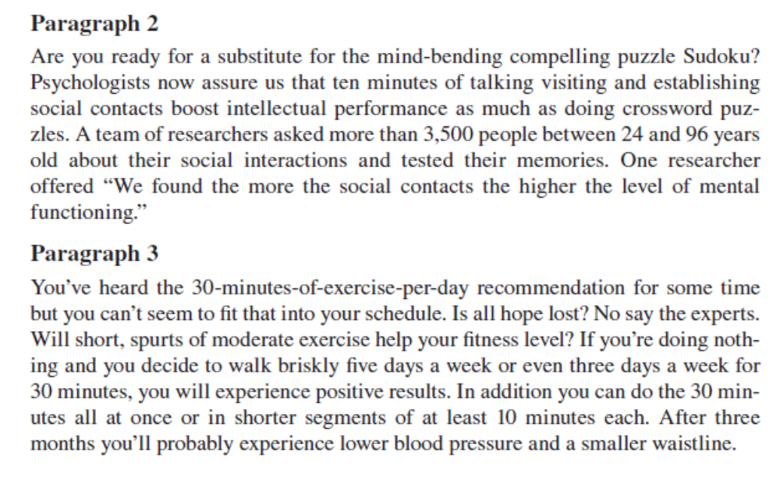
www.thewordsacademy.com

Slide 20
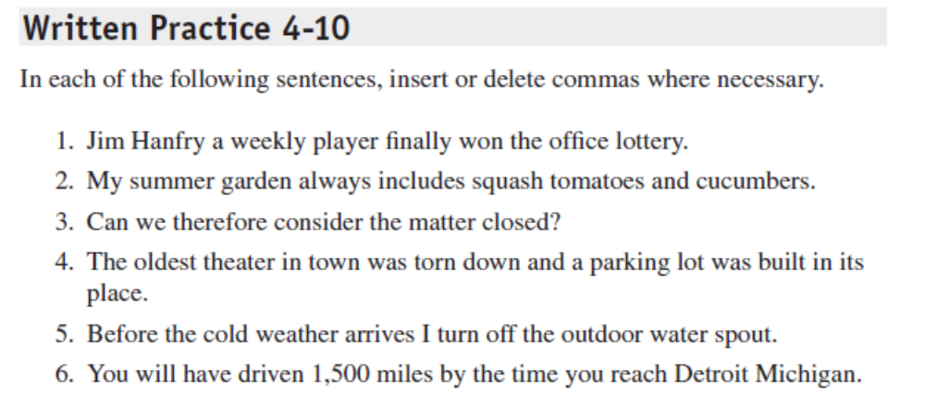
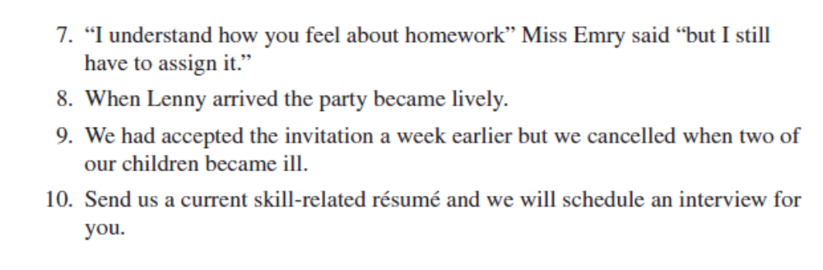
www.thewordsacademy.com

Slide 21
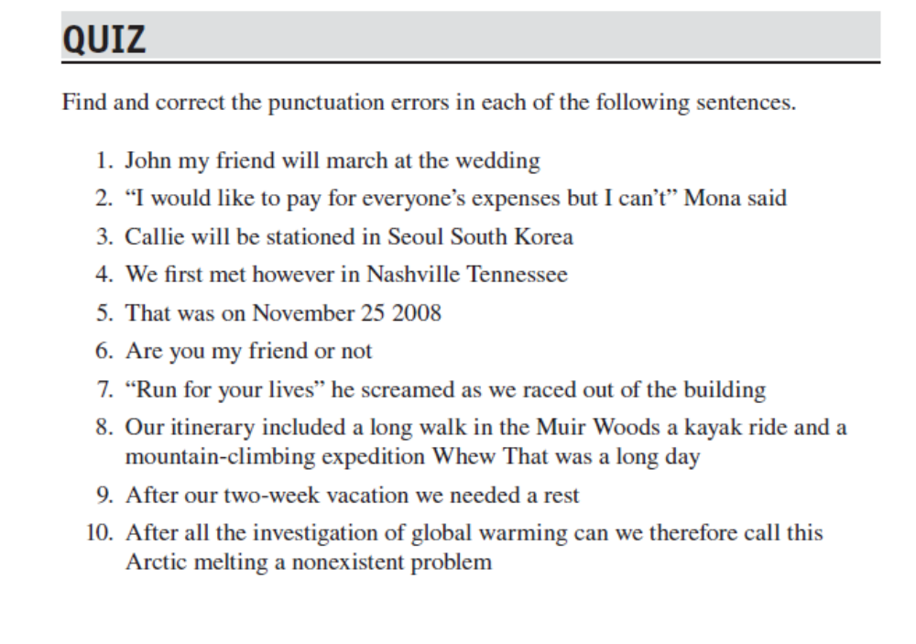
www.thewordsacademy.com

Slide 22
Capitalization
www.thewordsacademy.com

Slide 23
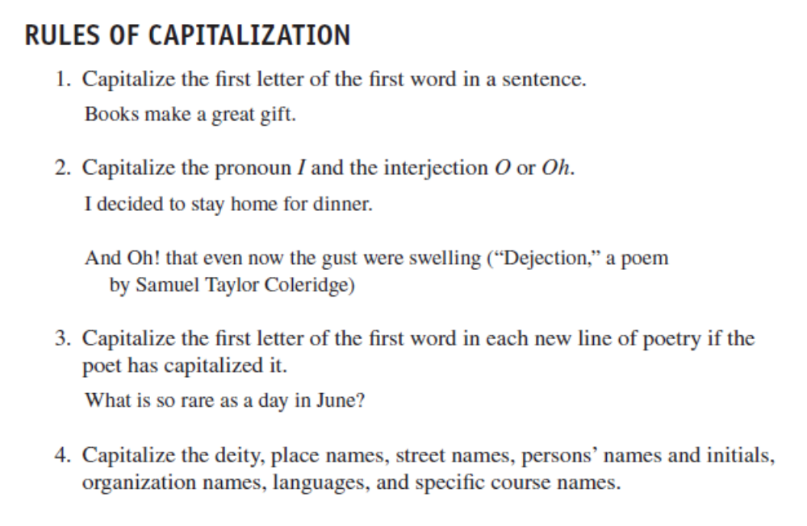
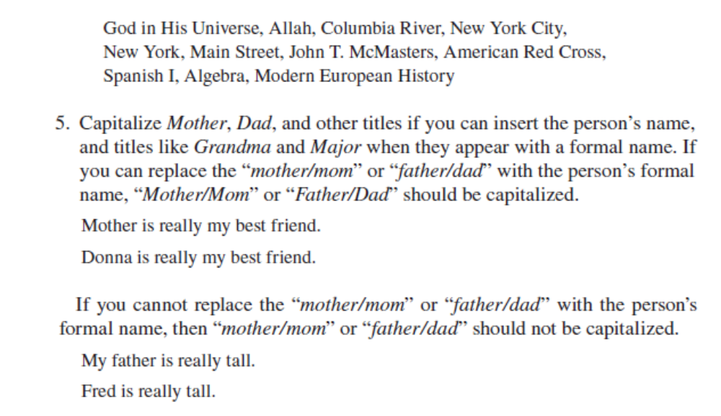
www.thewordsacademy.com

Slide 24
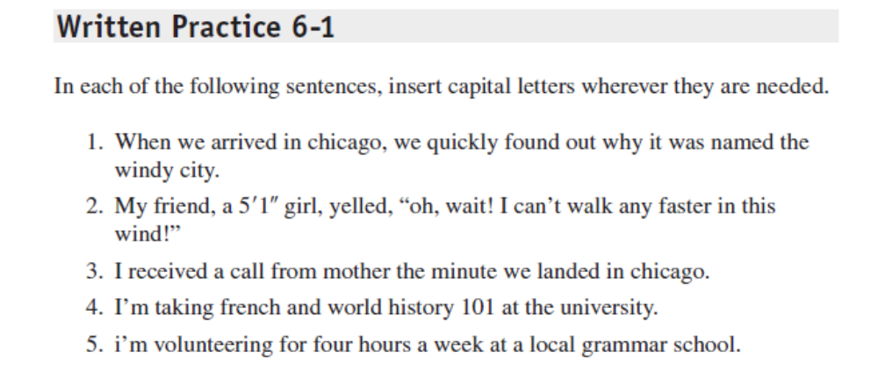
www.thewordsacademy.com

Slide 25
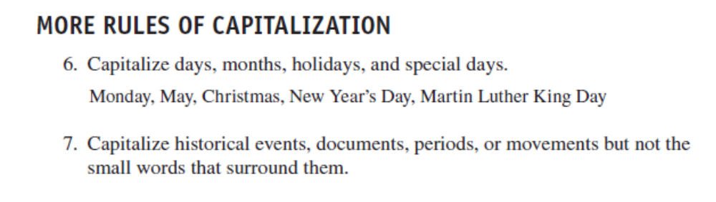
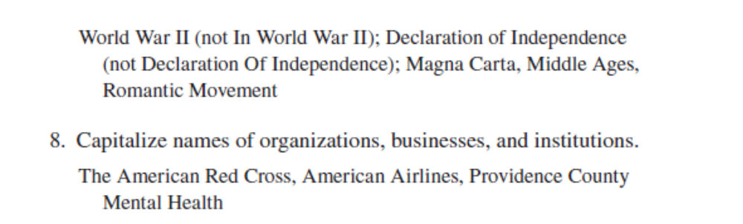
www.thewordsacademy.com

Slide 26
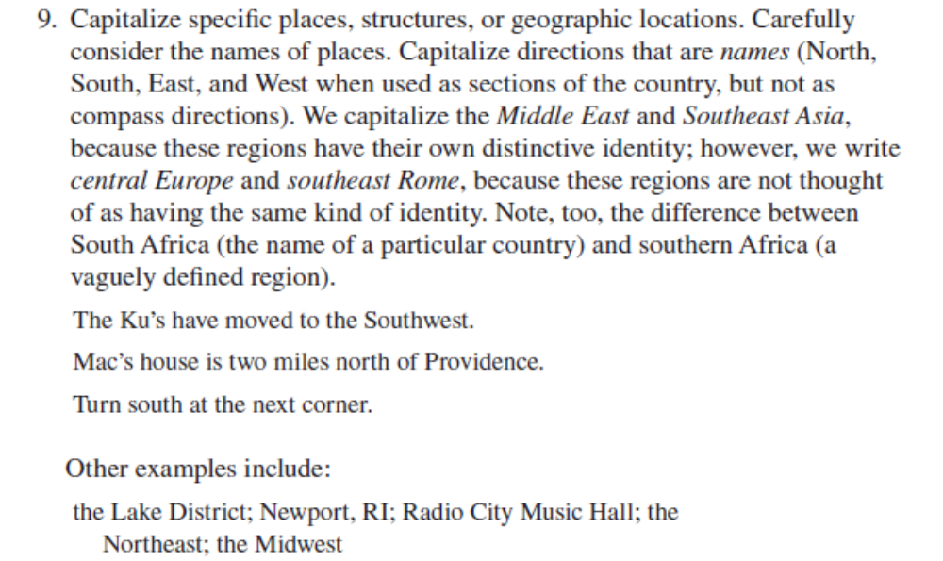
www.thewordsacademy.com

Slide 27
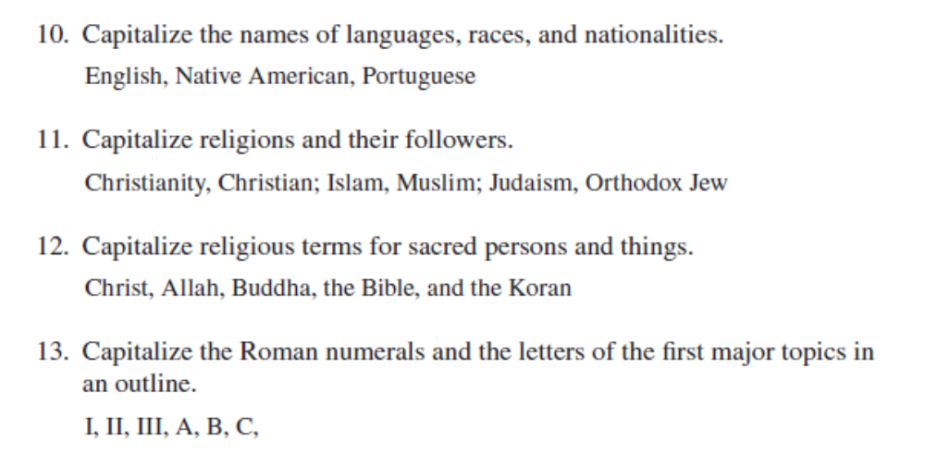
www.thewordsacademy.com

Slide 28
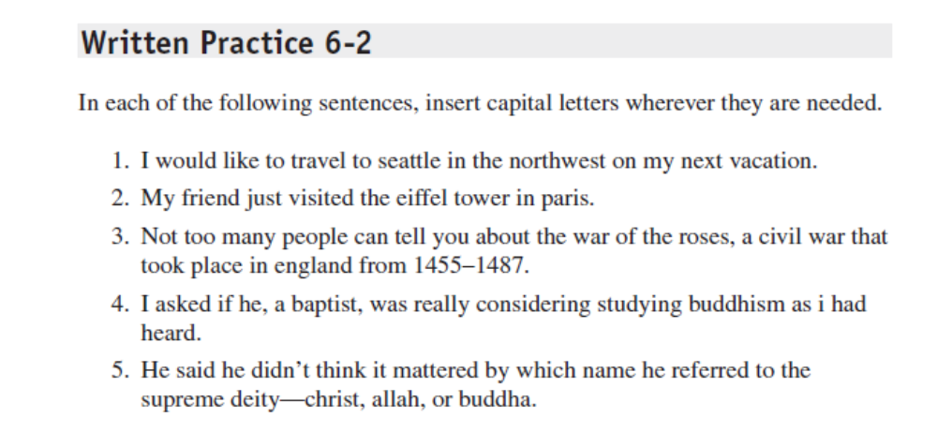
www.thewordsacademy.com

Slide 29
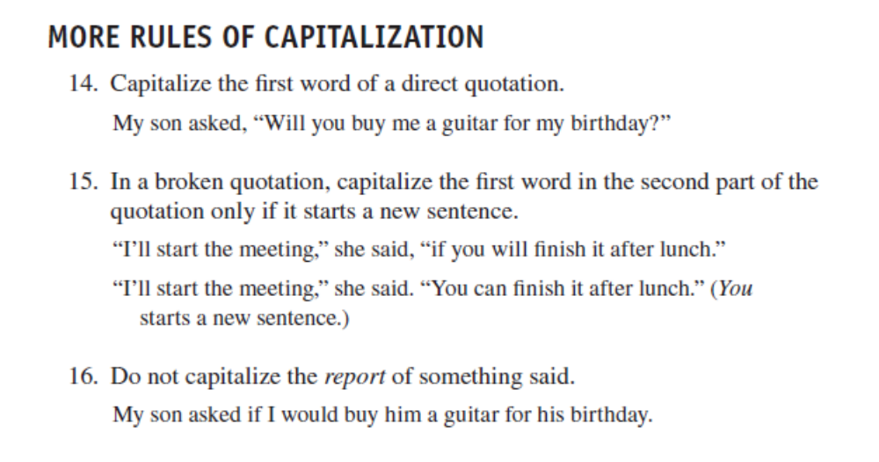
www.thewordsacademy.com

Slide 30
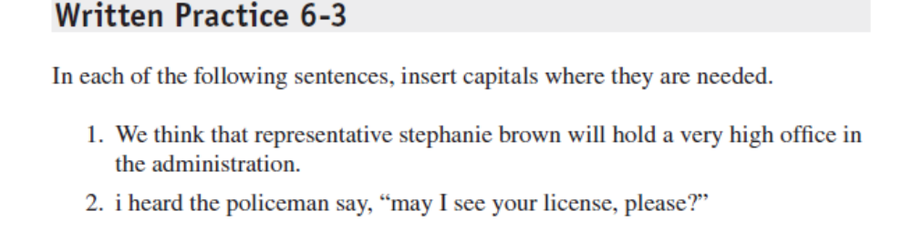
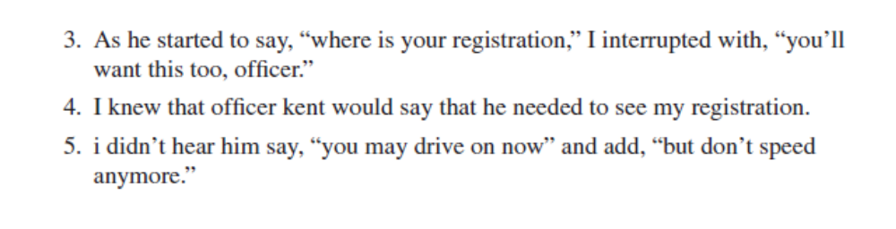
www.thewordsacademy.com

Slide 31
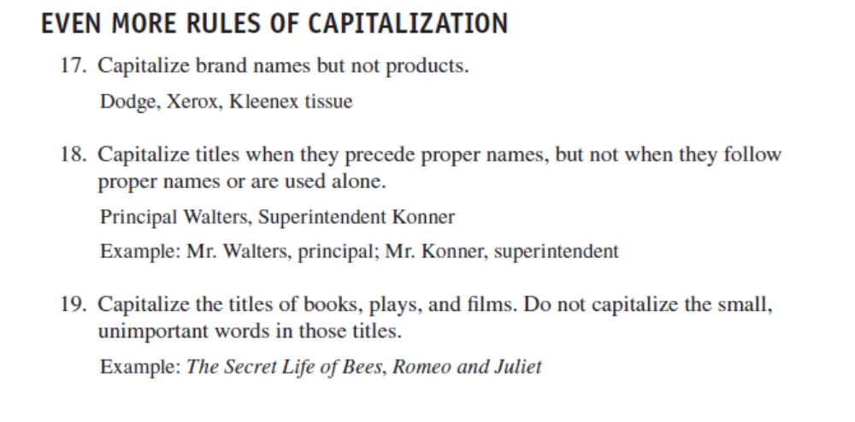
www.thewordsacademy.com

Slide 32
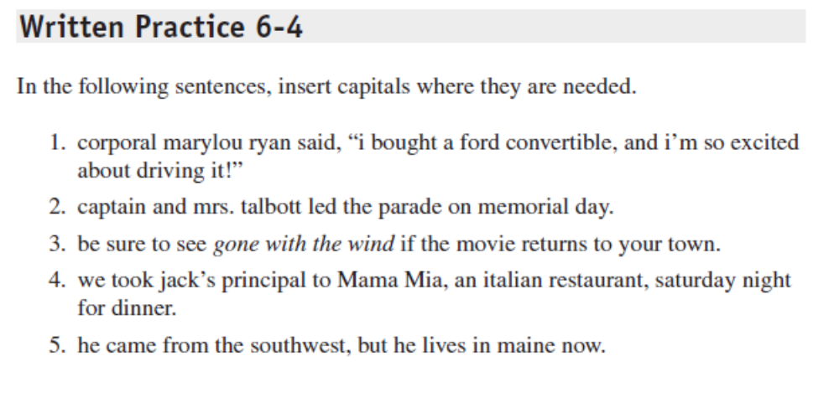
www.thewordsacademy.com

Slide 33
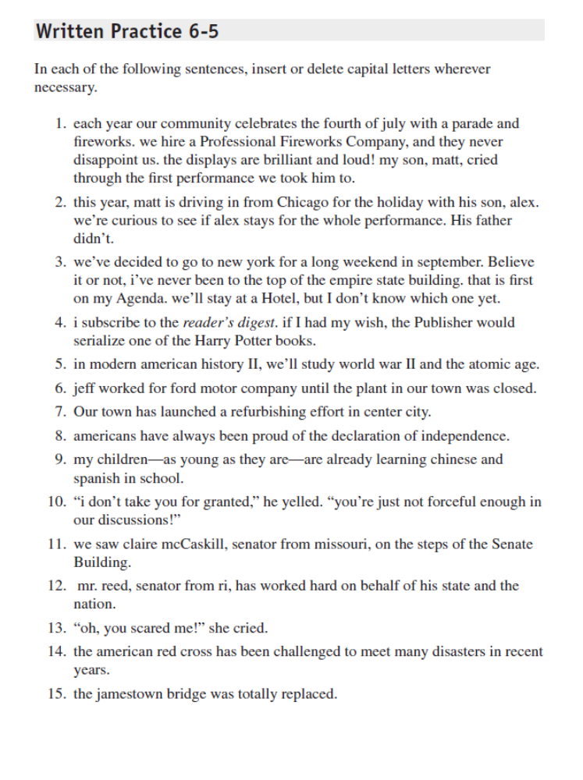
www.thewordsacademy.com

Slide 34
www.thewordsacademy.com

Slide 35
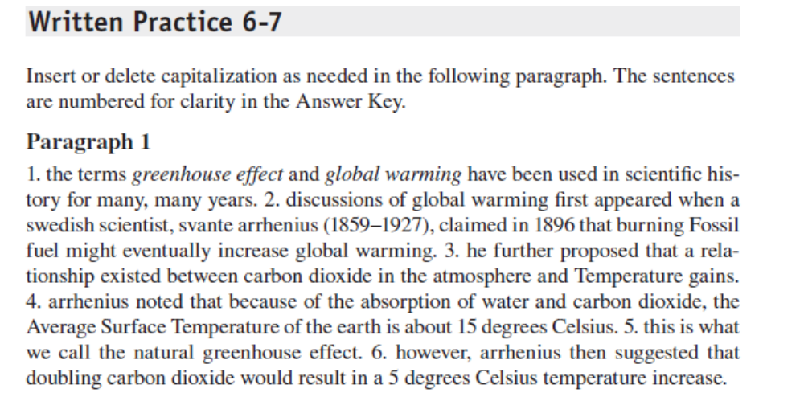
www.thewordsacademy.com

Slide 36
;
www.thewordsacademy .com
the semi colon

Slide 37
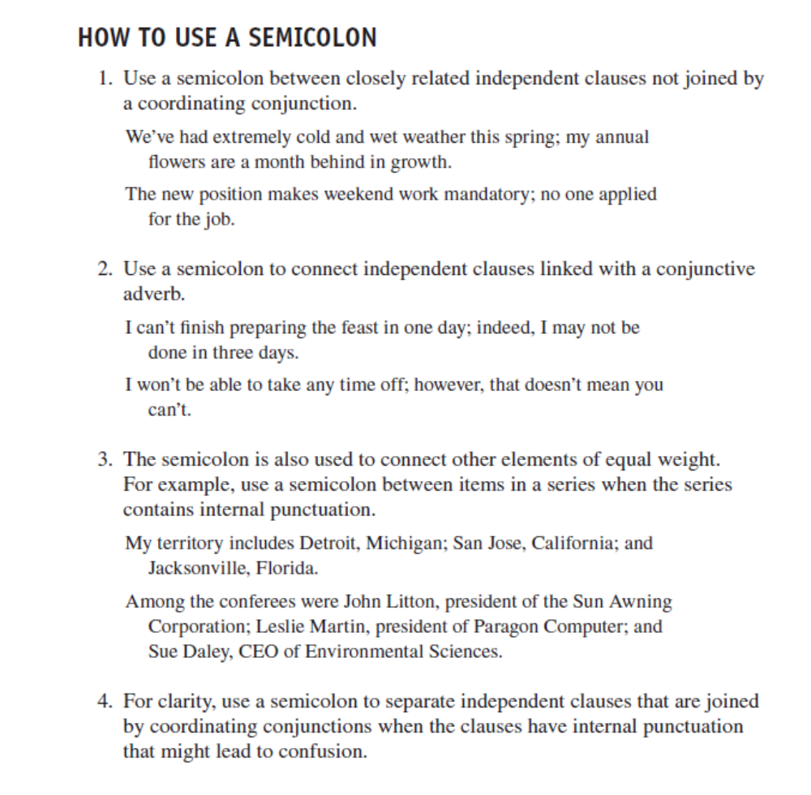
www.thewordsacademy.com

Slide 38
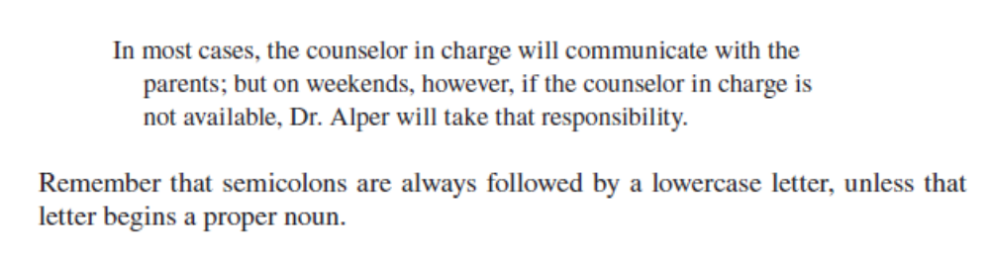
www.thewordsacademy.com

Slide 39
Questions?
May all your punctuations come through.
www.thewordsacademy.com

