Slide 1
The sen ten ce
THE WORDS ACADEMY
Processing Ideas
Sentenced for
poor
sentences.
WWW.THEWORDSACADEMY.COM

Slide 2
sentence.
Noun - a group of words, usually containing a verb, that expresses a thought in the form of a statement, question, instruction, or exclamation and starts with a capital letter when written:
NOUN - a punishment given by a judge in court to a person or organization after they have been found guilty of doing something wrong:
Cambridge online dictionary
WWW.THEWORDSACADEMY.COM

Slide 3
thought
the act of thinking about or considering something, an idea or opinion, or a set of ideas about a particular subject:
WWW.THEWORDSACADEMY.COM

Slide 4
3 types of sentences
Simple – no subordinate clauses
Compound – and, but, or, as, with, so.
Complex – even though, although, while, when, after, because.
Try to keep your sentences as short as possible. It makes it EASIER to READ, to UNDERSTAND and to REMEMBER while reading on.
WWW.THEWORDSACADEMY.COM

Slide 5
Simple sentences
One clause.
  The students played basketball and tennis yesterday.
  The vehicle moved slowly.
  The BMW and the Benz moved at snail pace.
WWW.THEWORDSACADEMY.COM

Slide 6
Compound sentences
  MORE THAN ONE SUBJECT OR OREDICATE
    The students started playing basketball, but then decided to go to the cinema.
    I had to wash the clothes, cook dinner and clean the rooms, so I was tired when they came.
    It was getting late, and the teacher had not arrived yet.
WWW.THEWORDSACADEMY.COM

Slide 7
Complex sentence
CONTAINS SUBORDINATE CLAUSES = independent clause + dependent clause.
  After the rain ceased, he began to walk home.
  Before the taxi arrived, he ran to the supermarket and bought some chocolates for her.
  While she was gazing at the handsome boy, the thief stealthily snatched her purse.
  Although very nutritious, vegetables are not that popular.
WWW.THEWORDSACADEMY.COM

Slide 8
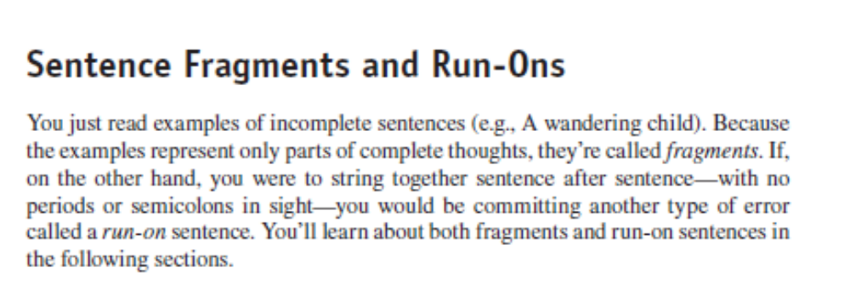
WWW.THEWORDSACADEMY.COM

Slide 9
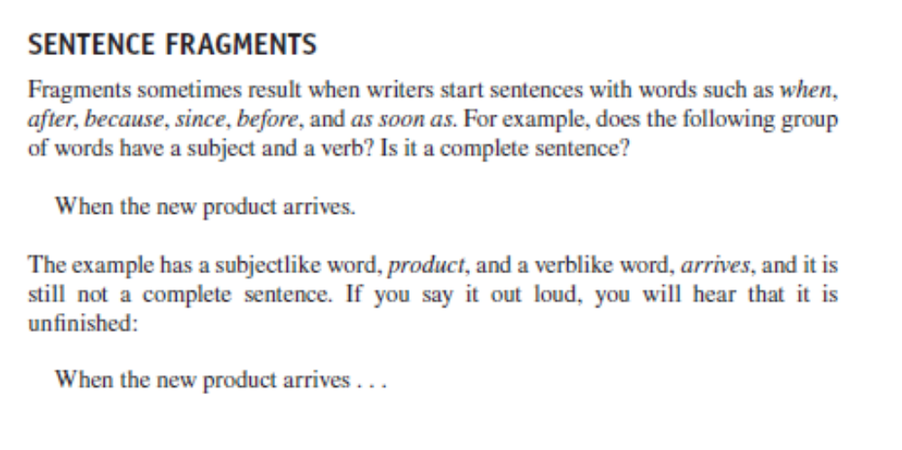
WWW.THEWORDSACADEMY.COM

Slide 10
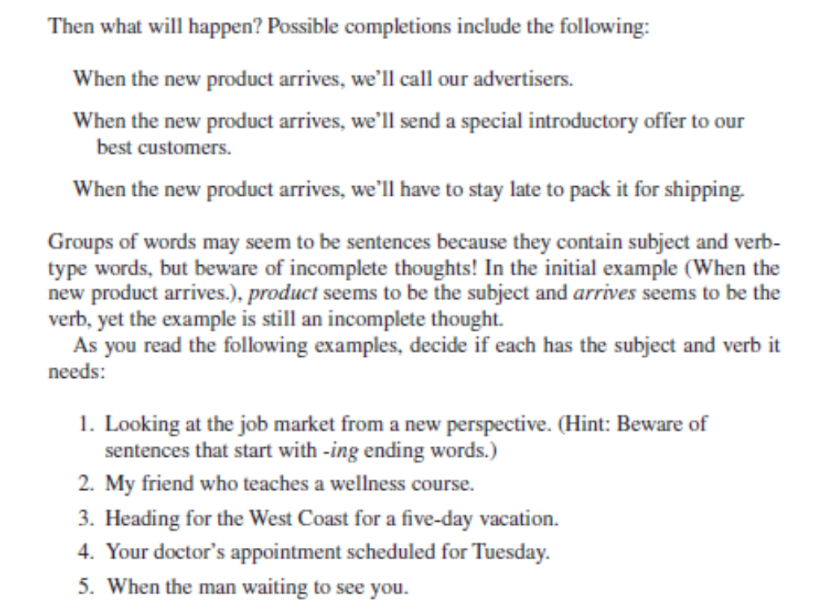
WWW.THEWORDSACADEMY.COM

Slide 11
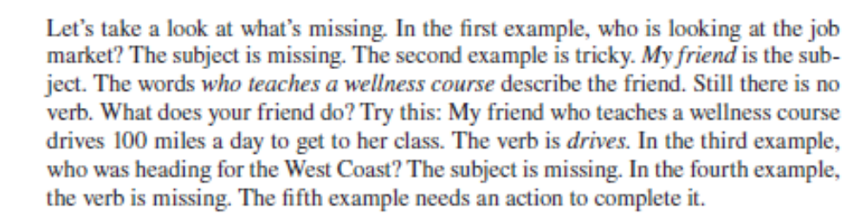
WWW.THEWORDSACADEMY.COM

Slide 12
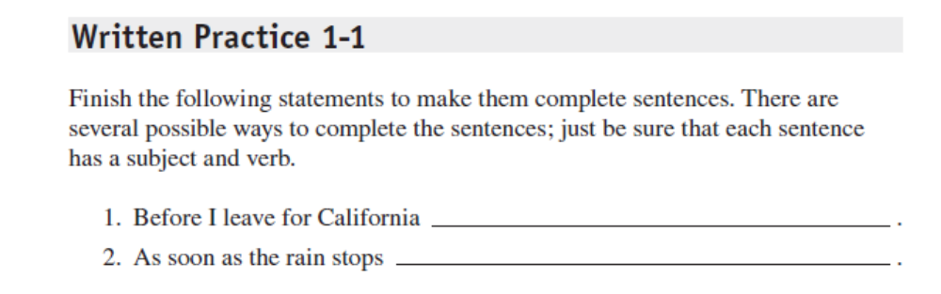
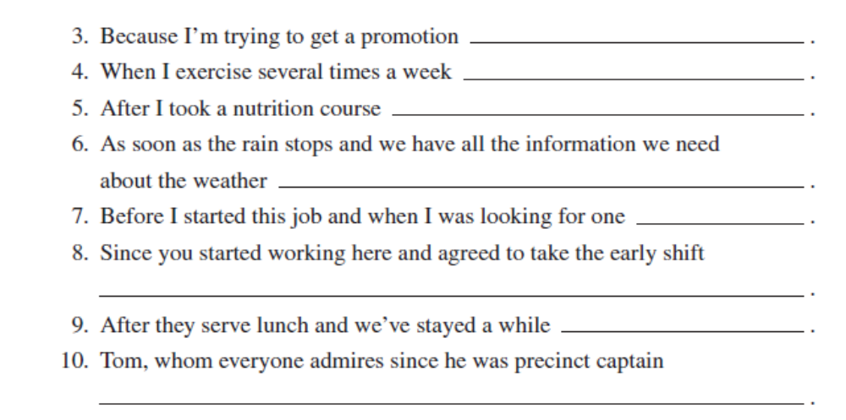
WWW.THEWORDSACADEMY.COM

Slide 13
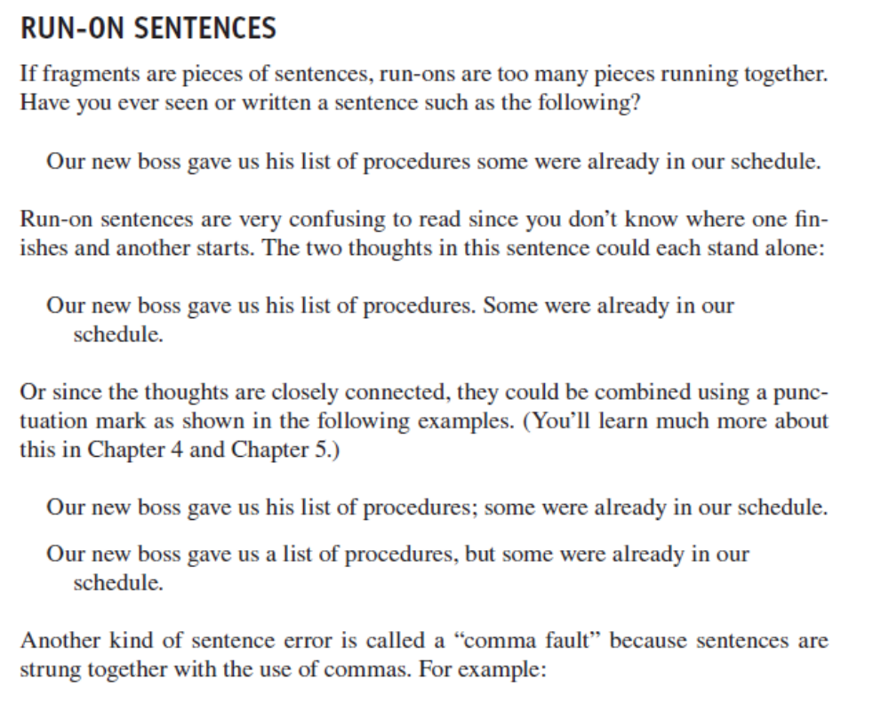
WWW.THEWORDSACADEMY.COM

Slide 14
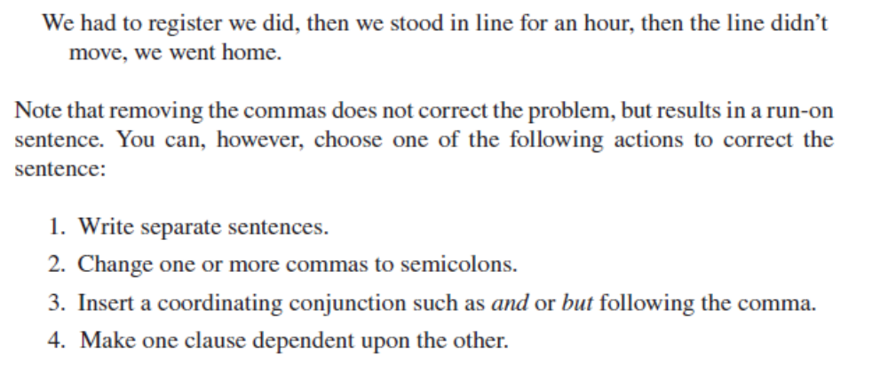
WWW.THEWORDSACADEMY.COM

Slide 15
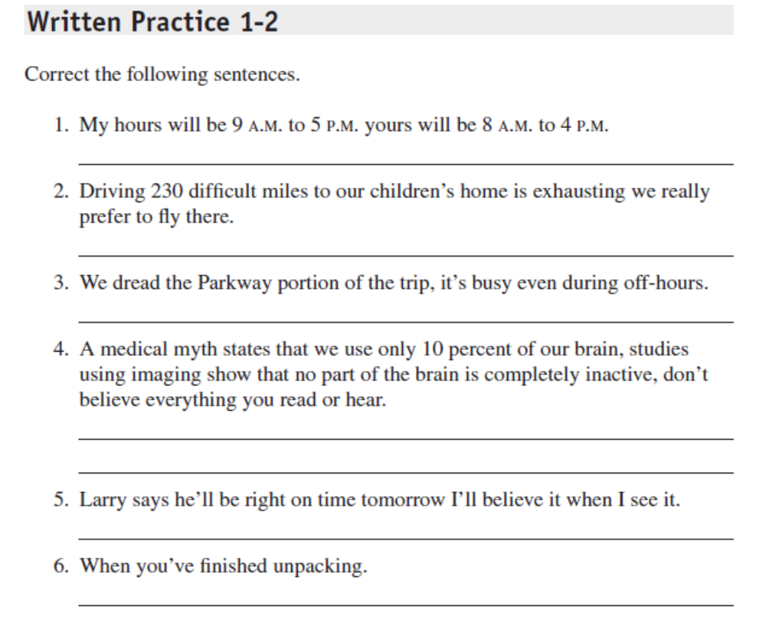
WWW.THEWORDSACADEMY.COM

Slide 16
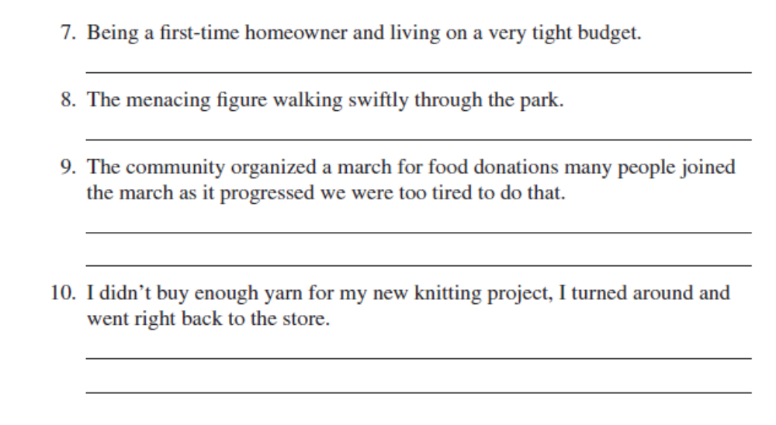
WWW.THEWORDSACADEMY.COM

Slide 17
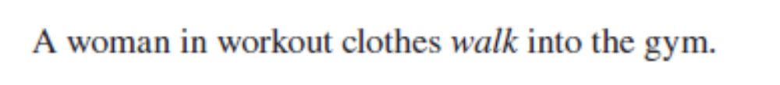
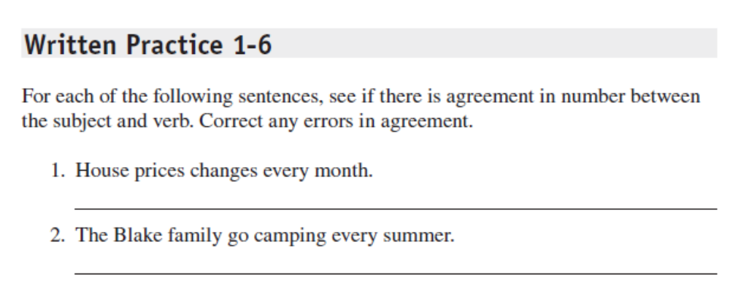
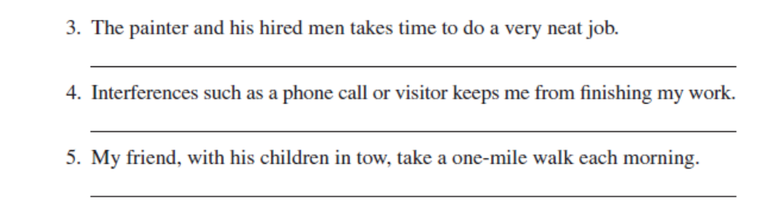
WWW.THEWORDSACADEMY.COM

Slide 18
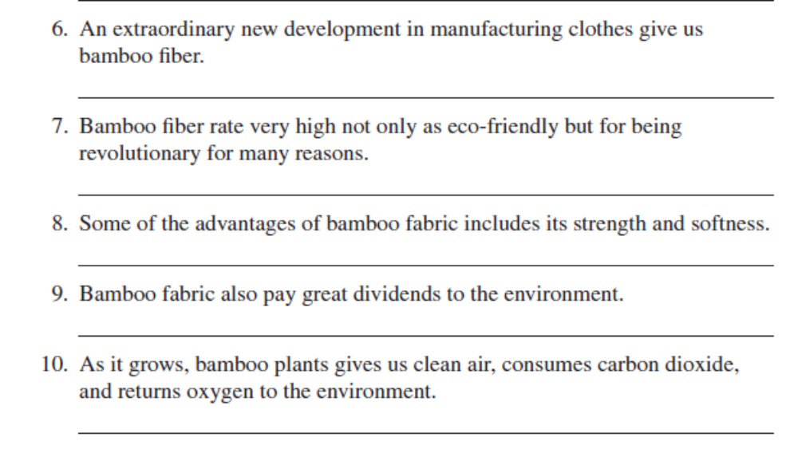
WWW.THEWORDSACADEMY.COM

Slide 19
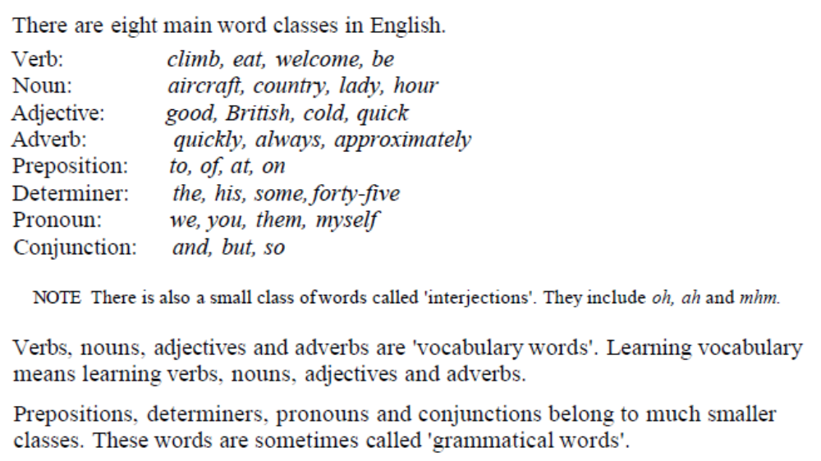
information
WWW.THEWORDSACADEMY.COM

Slide 20
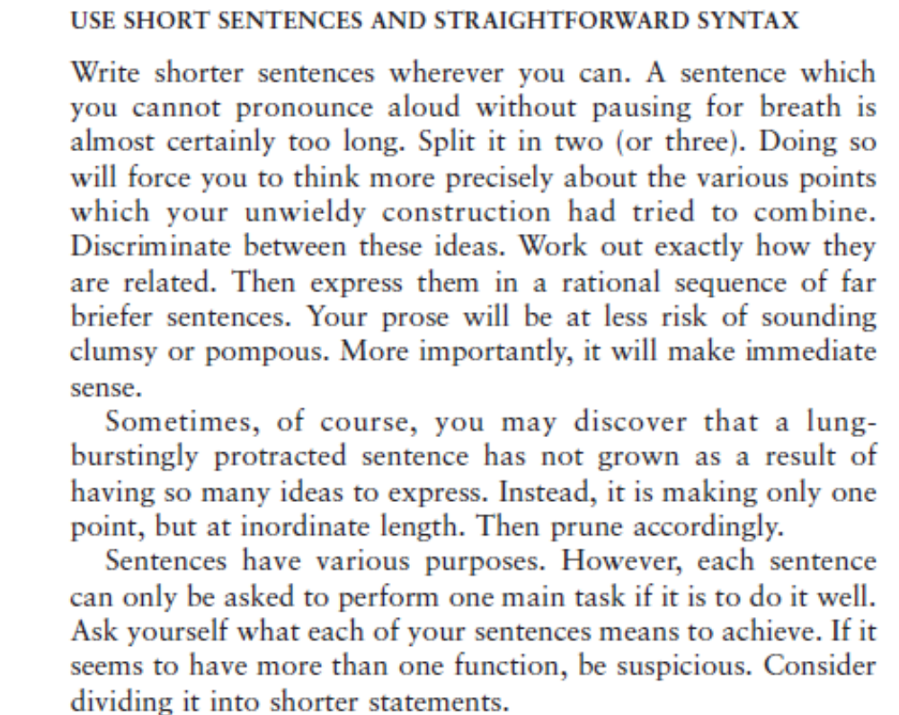
Advice for academic writing
WWW.THEWORDSACADEMY.COM

Slide 21
How many thoughts? Group work
I like school, but sometimes it is too boring or frustrating because I am a kid and kids love to run around and have fun which I do not get to do often enough and that makes me go crazy because playtime is something important to the development of a child’s mental, physical and social well-being so I think schools should definitely look into the amount of playtime that is given to children which I think might even have a positive impact on their learning.
WWW.THEWORDSACADEMY.COM

Slide 22
Breakdown the ideas to tiny bits
I like schools.
Sometimes schools are boring and frustrating.
Children love to run around and have fun.
But I do not get to play that often and that makes me mad.
Playing is something important to the mental, physical and social well-being of a child.
Schools should give more playtime
It might even increase their learning skills.
WWW.THEWORDSACADEMY.COM

Slide 23
1+1 = 2, 1+1+1= 3
Even though I like school, it [tends to get/is] boring and frustrating at times.
I am a child and I like to play a lot but don’t get the chance to, which makes me angry.
Schools should give more prominence to playtime because it is important to the social, physical and psychological development of the child and will lead to better learning skills.
WWW.THEWORDSACADEMY.COM

Slide 24
Break it to ‘peaces’ – Group work
I think peaceful behaviour is something children can learn. if they are taught how to deal with situations that are difficult, they will be able to apply them when they grow up. Also, children learn how to behave by looking at parents and maybe parents should also take peace related lessons that teach you how to deal with conflict, and schools should also introduce peace related lessons which should be practical.
WWW.THEWORDSACADEMY.COM

Slide 25
Piece it together
peaceful behaviour is something children can learn
if they are taught how to deal with situations that are difficult, they will be able to apply them when they grow up
children learn how to behave by looking at parents
parents should also take peace related lessons that teach you how to deal with conflict
schools should also introduce peace related lessons which should be practical.
WWW.THEWORDSACADEMY.COM

Slide 26
Untangle the data -
Social media is very useful for me as I keep in touch with all my friends and am updated about the latest trend and news so that I am not left out when others talk and it helps me post and share things that interest me and it helps me organize events in our class or school, but there also negative sides such as spending too much time, screen time affecting eye-sight, being too dependent on social media which shows us that we need to balance the usage.
WWW.THEWORDSACADEMY.COM

Slide 27
Social media
Social media is very useful for me as I keep in touch with all my friends
am updated about the latest trends and news
I am not left out when others talk
post and share things that interest me
organize events in our class or school
spending too much time, screen time affecting eye-sight, being too dependent on social media
we need to balance the usage
WWW.THEWORDSACADEMY.COM

Slide 28
reassemble
Social media helps me connect with my friends at any given time.
Because it enables me to be updated about new trends and news, I won’t be left out by my friends in their conversations.
I use social media to post and share my interests as well as organizing class and school related events.
However, not using social media with caution may lead to dependency on it, bad eye-sight and wastage of time.
WWW.THEWORDSACADEMY.COM

